Slide 1
Debrief 06/04/23

Slide 2
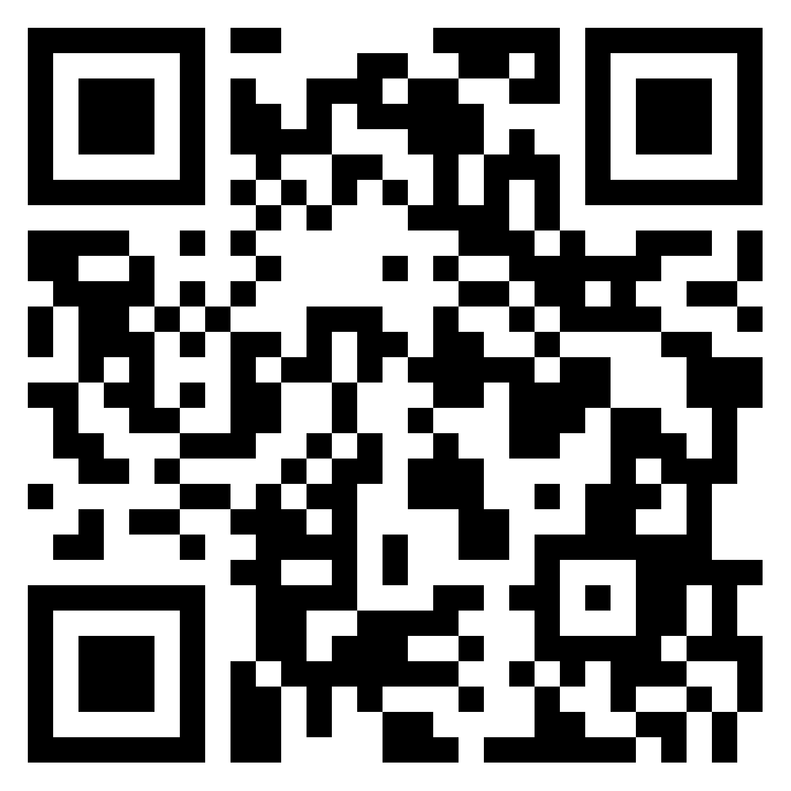
Reflection – Week 4
https://padlet.com/woeiluen/tap-2023-weekly-reflection-week-4-pkyk10xvrbq4zaui

Slide 3
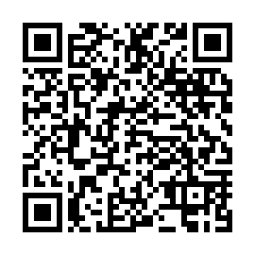
Week 4 Survey
https://tomowork.typeform.com/to/ubTKW11e

Slide 4



Week 5: Corporate Project & Start of Mentorship
 | Monday 10 April | Tuesday 11 April | Wednesday 12 April | Thursday 13 April | Friday 14 April
10.00am to 12.30pm | Corporate Project Meeting Project Sponsors 2 | Corporate Project | Job Readiness Workshop Mentorship Session 1 | Job Readiness Communications Workshop | Digital Skills Learning
12.30pm to 2pm | Lunch Break | Lunch Break | Lunch Break | Lunch Break | Lunch Break
2pm to 4.30pm | Corporate Project | Corporate Project | Job Readiness Workshop Corporate Profile Shot | Job Readiness Communications Workshop | Digital Skills Learning
In-person session at
Republic Polytechnic
Work From Home (WFH)
Flexible arrangement
Company Visit

Slide 5
Programme for 10th April 2023 (Monday)
Time | Event | Venue
9.50am | Report to Republic Poly
10am -12.30pm | Corporate project | Classroom E19A – Kinjo Rubber LIBN1 – MSD LIBN2 – foodpanda LIBN3 – EVCO LIBN4 - Micron
12.30pm – 2pm | Lunch | Lunch is provided
2pm – 2.30pm | Mentorship Briefing | Classroom E19A
2.30pm - 4pm | Corporate project
4pm – 4.30pm | Debrief
4.30pm | Dismissal
Things to Bring: Laptop with Charger, money for lunch, writing materials and handphone
Wear: Smart Casual

Slide 6
Mentoring Session Slots and Topics
Date | Time | Session | Details
12th April | 11:00am -12:00pm | Mentorship Session 1 | Getting to know each other and goal setting for what the student wants to get out of the mentorship
11th May | 2:30pm – 3:30pm | Mentorship Session 2 | Career Coaching (Charting Career path and Skillsets required)
25th May | 2:30pm – 3:30pm | Mentorship Session 3 | Mock Interview, any other question and closing off
We will provide you with a ZOOM link before the mentoring session and use the breakout room function for one-on-one mentoring.
When your mentor is not available for the slot, you will arrange an alternative slot with your mentor.
Friday is preferable via ZOOM, Teams, or Google Meet, based on the agreement with your mentor.

Slide 7
Next step
We will send your mentor information via Teams chat one by one. In most cases, the information is their LinkedIn.
Some mentees will have the 1st session on 14 April Friday or 21 April Friday, because of the mentor’s unexpected schedule conflict. We will instruct you individually.
Prepare for the 1st mentoring session and ensure to explain mentor what you want to take away from the mentorship.

Slide 8
As a mentee…
You need to take ownership of the relationship.
You need to state what you want to get out of the session
You need to share what you are thinking
You need to ask questions
You need to confirm the next appointment
You need to make sure you get the most out of this mentorship opportunity

